Slide 1
HTML
FAVICON
Maria Angelica Paghid

Slide 2
What is a Favicon?
A favicon is a small image displayed next to the page title in the browser tab.

Slide 3
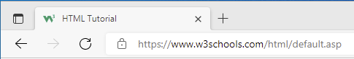
A favicon image is displayed to the left of the page title in the browser tab, like this:
Example:

Slide 4
To add a favicon to your website, either save your favicon image to the root directory of your webserver, or create a folder in the root directory called images, and save your favicon image in this folder. A common name for a favicon image is "favicon.ico".

Slide 5
Next, add a <link> element to your “index.html” file, after the <title> element, like this :
Example:
<!DOCTYPE html> <html> <head> <title>My Page Title</title> <link rel="icon" type="image/x-icon" href="/images/favicon.ico"> </head> <body> <h1>This is a Heading</h1> <p>This is a paragraph.</p> </body> </html>

Slide 6
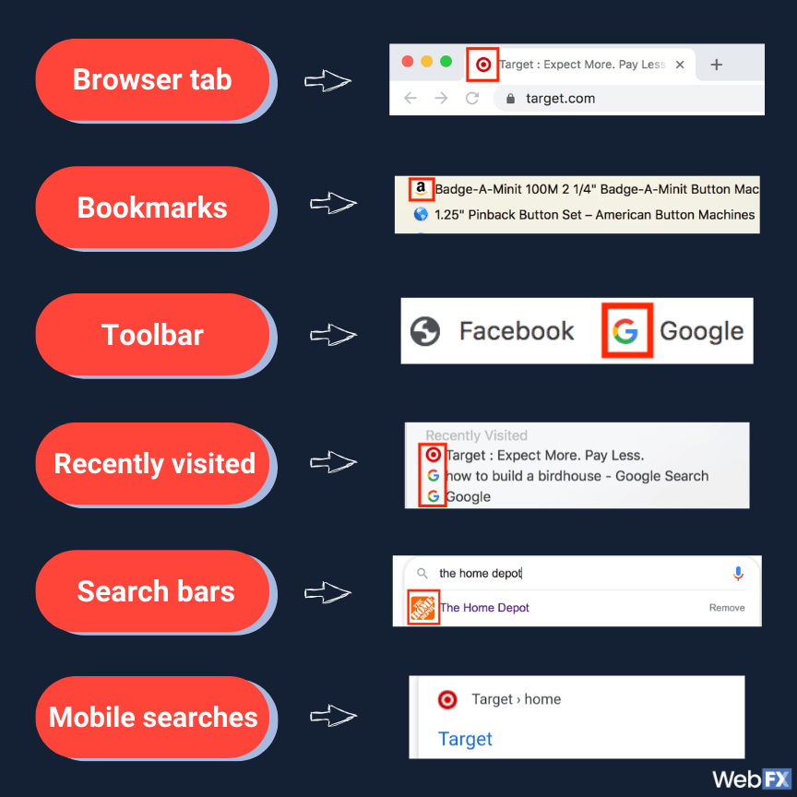
Example of Favicons

Slide 7
What is the purpose of Favicon?
A favicon is a small 16x16 pixel icon that serves as branding for your website. It’s main purpose is to help visitors locate your page easier when they have multiple tabs open. Due to their size, favicons work best as simple images or one-to-three characters or text.

Slide 8
What happens if you don’t have a favicons?
Without them, our open browser tabs feel empty. We’re left with a bunch of grey space with text, which is far from noteworthy. Favicons provide visual cues that help people recognize and more importantly remember you brand.

Slide 9
Thank you

